Slide 1
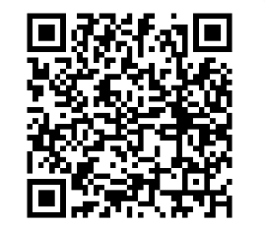
Got Tech?
Using Technology to Access Educational Materials
Elizabeth Echebarria, M.Ed
Robbin Dunn, M.Ed
WCSD

Slide 2
Who are we?
(screenreader)
Robbin
Elizabeth
Special Education Teacher in WCSD – 10 years
Bachelor’s in Elementary and Special Education; Master’s in Early Childhood Special Education
Assistive Technology Consultant
Former Officer and Member of the Nevada Branch of Council for Exceptional Children’s Division of Early Childhood
Advocate for a school-aged family member recently identified as having dyslexia
Mom to a two-year old daughter
Special Education teacher by heart and education – 25 years
Bachelor’s in Elementary and Special Education; Master’s in Curriculum and Instruction
Assistive Technology Consultant
Adjunct Faculty – University of Nevada, Reno
Special Education Mentor/Facilitator for New Teacher Center
State Board Member: Nevada Governor’s Council on Developmental Disabilities and Special Education Advisory Committee

Slide 3

Today’s Agenda
AEM – Accessible Educational Materials
  Barriers
IDEA – Individuals with Disabilities Education Act
Dispelling Myths: AT is NOT a Crutch
Implementation
Exploration – Free Resources, Chrome, iOS
Dyslexia and AEM
Let’s Practice….
UDL – Universal Design for Learning

Slide 4
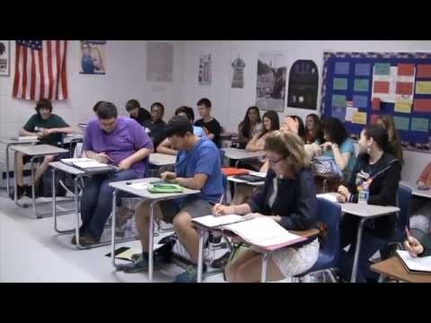
AEM (Accessible Educational Materials) and UDL (Universal Design for Learning): An Introduction
Youtube: AIM and the 21st Century Classroom
https://www.youtube.com/watch?v=Q0HHlWRqQis&t=22s

Slide 5

Barriers at school…..
What are some reasons students choose not to do their work or participate?
What are some reasons students choose not to use their assistive technology?
Implementation (or lack of) is most common issue with AT

Slide 6

AEM (Accessible Educational Materials) and UDL (Universal Design for Learning): An Introduction
Youtube: UDL:Reducing Barriers
https://www.youtube.com/watch?v=xTShQyw3m80

Slide 7
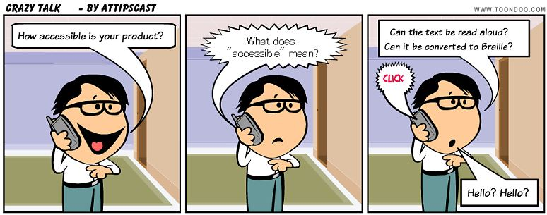
AEM (AIM)
Accessible Educational Materials
Accessible Educational Materials are required by law – the IEP team MUST consider whether the student can access their curriculum without accommodations, modifications or adaptations
AIM Basics
www.AEM.cast.org

Slide 8
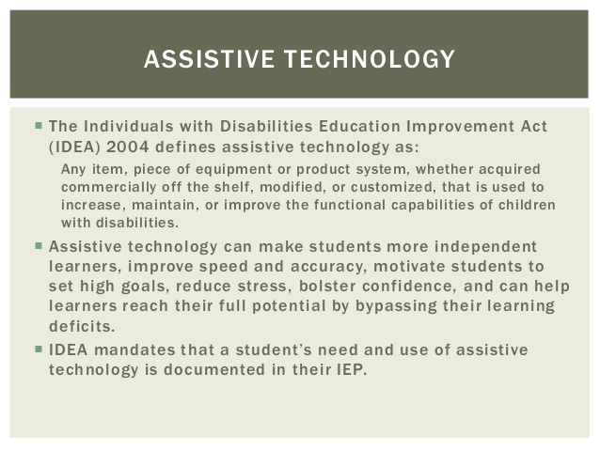
Individuals with Disabilities Education Act (IDEA)
IDEA (Individuals with Disabilities Education Act) specifically focuses on accessible formats of print instructional materials
  Testing?
  Concerns we commonly hear?

Slide 9

Motivation when introducing supports is key…
We need to consider (as educators and parents):
  What types of tasks do we have them doing?
  Are they motivating and personal?
  Are we scaffolding with high interest topics to allow them to learn to use technology?
  Are we modeling and teaching or just expecting them to “do it”?
  Are we giving them immediate feedback?

Slide 10
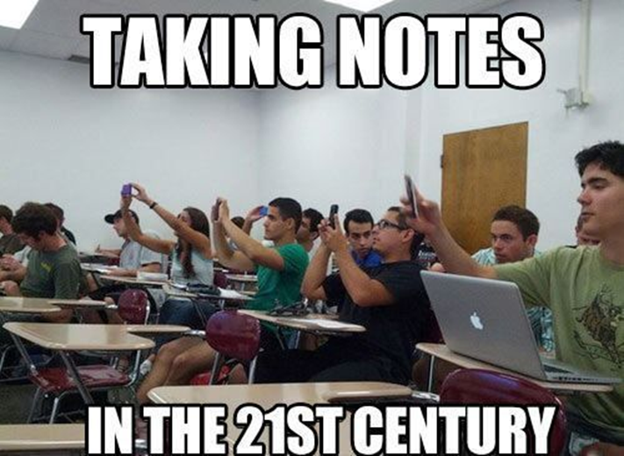
Dispelling myths: AT is Not a Crutch
The Case Against Assistive Technology
  https://www.youtube.com/watch?v=ny5n7F1FIaM
AT evens the playing field
AT can increase reading levels
AT increases engagement and confidence, allowing the learner to successfully complete assignments and expectations
  It can be used throughout their education and lifetime

Slide 11

Supports Continue Throughout Students’ Education
Most universities and community colleges have a Disability Resource Center (DRC)
Students have access to the same supports they use in K-12 education
The DRC evaluates their needs and provides them with what they will need for that environment
University of Nevada-Reno DRC: http://www.unr.edu/drc

Slide 12
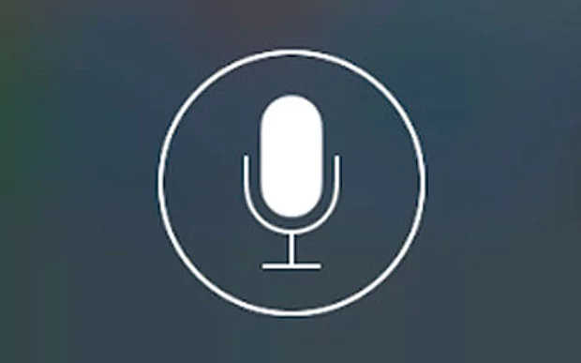
Common Technology Supports Used Include……
Text to speech (Snap and Read, screen readers, Speak feature, Google Chrome extensions)
Word Prediction (CoWriter, iOS/Siri)
Speech to Text (Windows Speech Recognition, Siri, Dragon Dictation)
  Can be frustrating for some students, use with caution due to testing requirements
  Should be used with text to speech
Grammar check (Word, Ginger)
Digital text (Bookshare, Overdrive, online texts, YouTube)
Keyboard alternatives (touchscreens, iAnnotate, )
(See AT website for more options (next slide)…..these are some of the supports typically used)

Slide 13
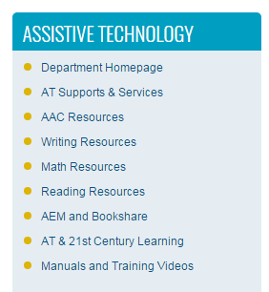
Implementation
“I’m a member of the student’s team. What can I do to ensure that my students have accessible materials?”
Washoe County Schools/Departments/Assistive Technology
  Http://www.washoeschools.net/Domain/278\\
  WCSD Website-
    Departments tab
      Assistive Technology
        AEM and Bookshare
        Reading Resources
Let’s Explore….

Slide 14
Bookshare and Digital Text
(Highlights and Need-to-Knows)
What is Bookshare?
  History
  Must have a print disability to use Bookshare
    https://www.bookshare.org/cms/bookshare-me/who-qualifies
  Not best resource for picture books
If not eligible, but digital text is necessary, school will need to provide
  Check other resources like YouTube, library, textbook publisher’s website, other schools, etc.
Need app to read downloaded books on a tablet

Slide 15

Chrome Web Store
Explore Web Store and Extensions
  http://www.controlaltachieve.com/2016/10/special-needs-extensions.html
  Note: You do not need a Google account or sign in to use extensions, although it is MUCH easier and your extensions will follow you from computer to computer
    To use extensions without an account:
      http://superuser.com/questions/633706/how-to-install-extensions-in-chrome-without-a-google-account

Slide 16
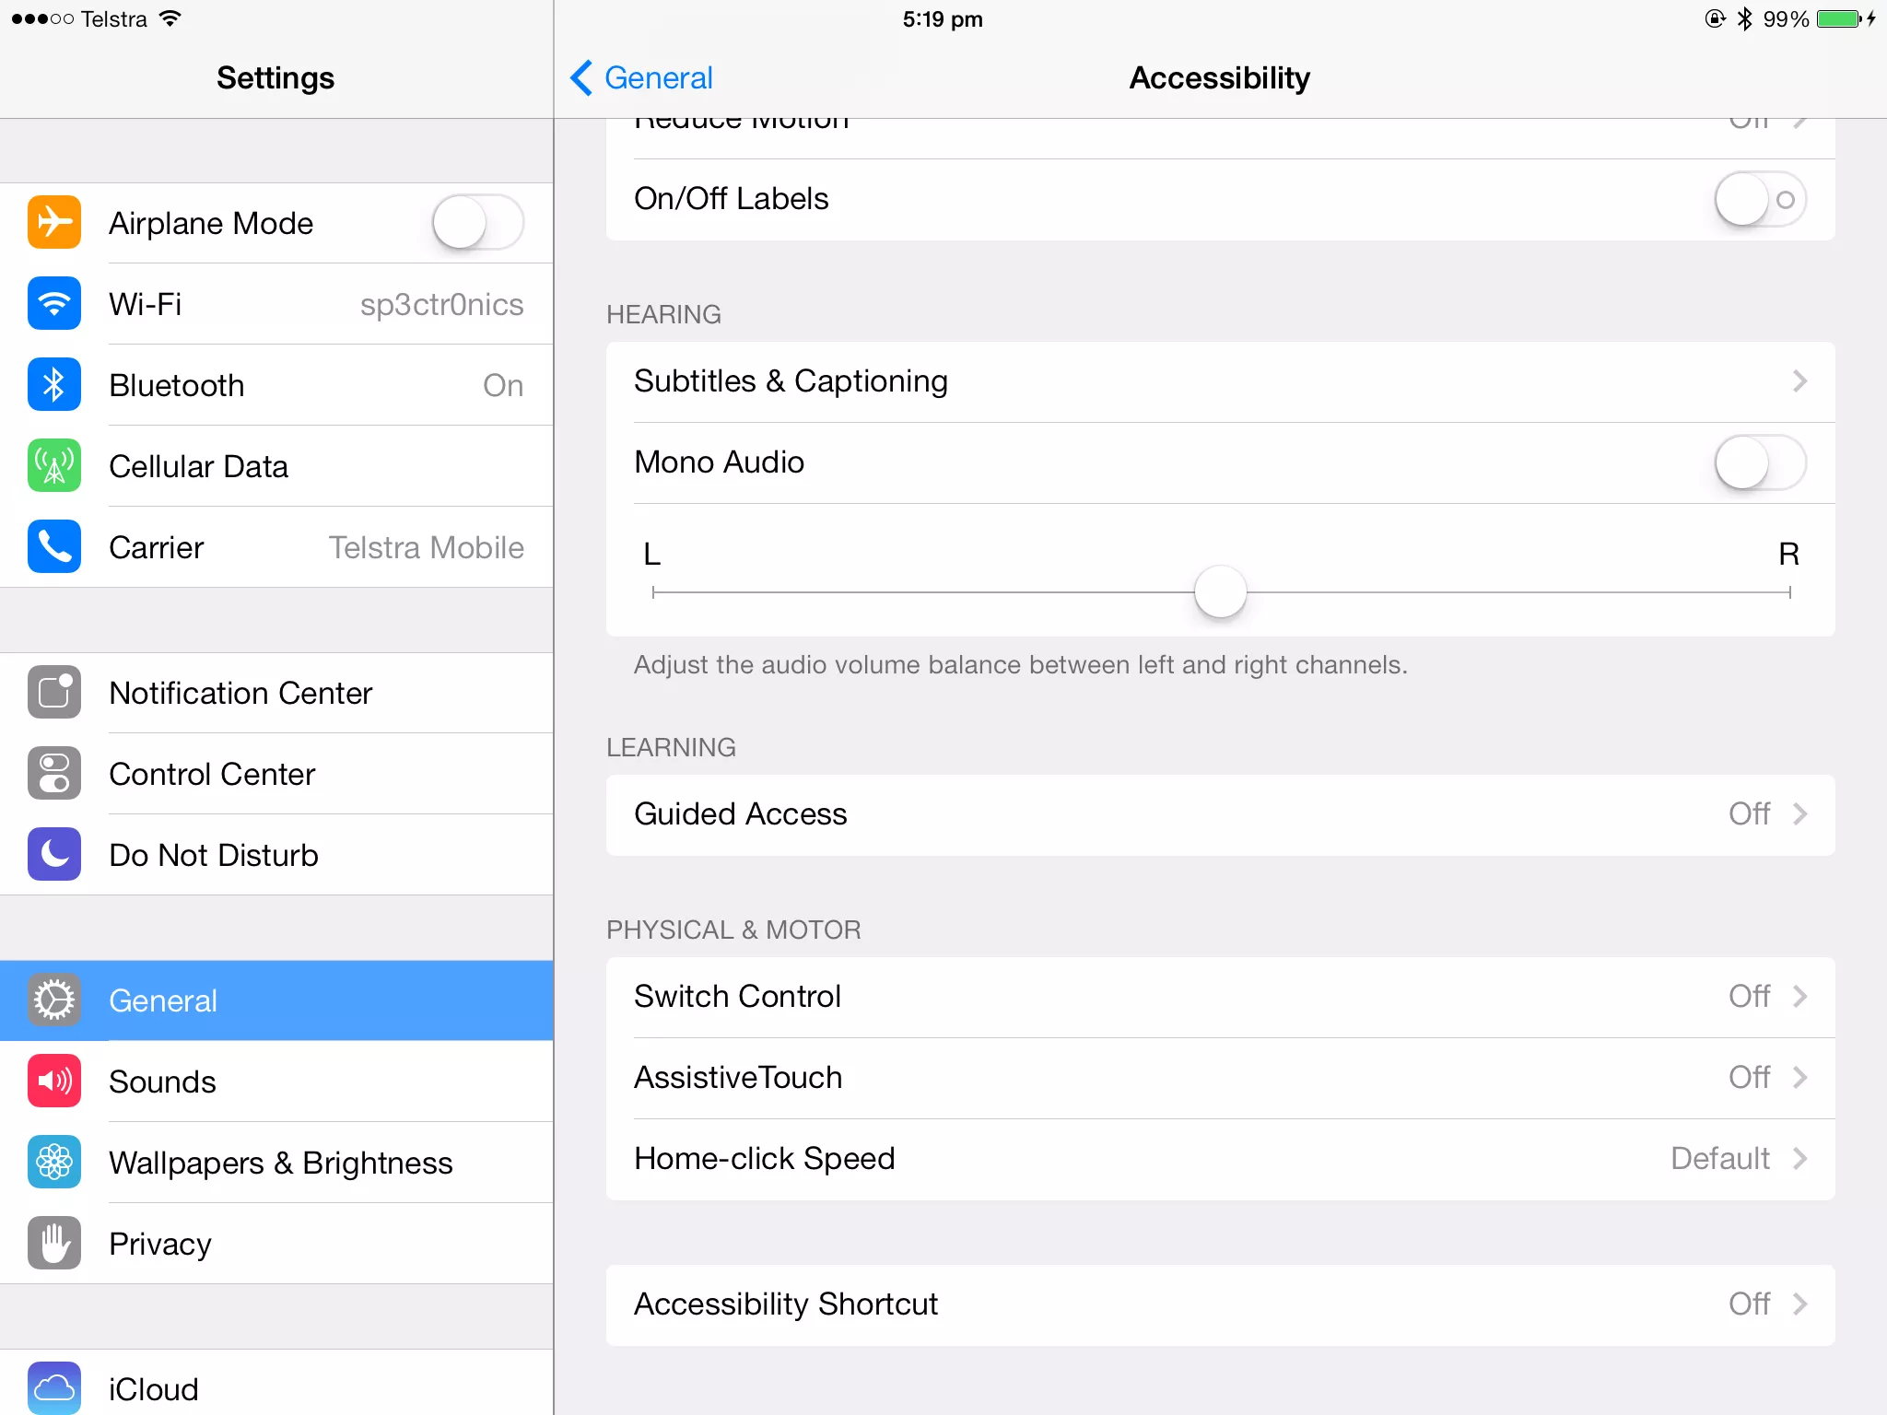
iOS Accessibility
iOS devices (iPhones, iPads etc.) have a wide variety of accessibility features built in
Accessibility for iPhone/iPad: The Ultimate Guide
  http://www.imore.com/accessibility-iphone-ipad

Slide 17

Dyslexia info
Dyslexia Resource Guide- http://www.doe.nv.gov/Office_of_Special_Education/
Google for Dyslexia: Using Chrome for Reading and Writing (Part One)
  https://www.noodle.com/articles/google-for-dyslexia-part-one
Google Extensions- Beeline Reader, OpenDyslexic font
Understood – for learning and attention issues
  https://www.understood.org/

Slide 18
Case studies…what would you field test?
Johnny Jim is a 5th grade student demonstrating difficulty in the area of written expression. He requires access to word processing for all written assignments due to dysgraphia. Use of a portable computer for word processing is made available to him through the school site’s 1-to-1 technology program.
Laura is a 4th grade student who’s independent reading level is currently at the 1st grade level. She has excellent auditory comprehension. She has access to laptops on a cart, library and classroom computers.

Slide 19

Activity:
Think of a student and list current barriers for that specific student to accessing the curriculum
Find a partner and share your list of barriers
Discuss a tool or resource that you might use to remove the barriers for that specific student

Slide 20
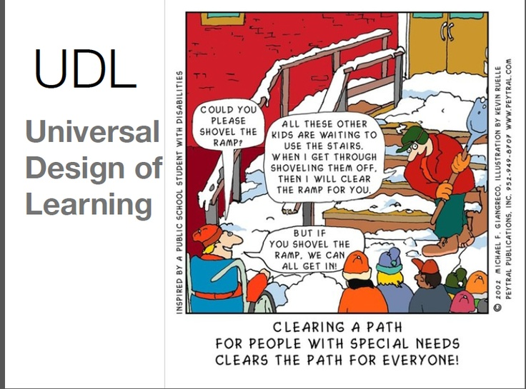
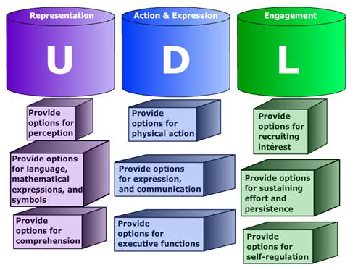
UDL
UDL Toolkit: https://udltechtoolkit.wikispaces.com/

Slide 21
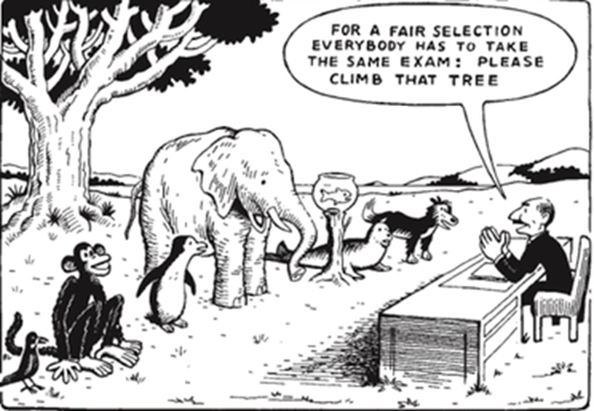
#thankyou
Elizabeth Echeberria, M.Ed
Robbin Dunn, M.Ed.
eecheberria@washoeschools.net
rdunn@washoeschools.net
Presentation
(need Dropbox)

Slide 22
References and Resources
AIM and the 21st Century Classroom: https://www.youtube.com/watch?v=Q0HHlWRqQis&t=22s
UDL:Reducing Barriers: https://www.youtube.com/watch?v=xTShQyw3m80
AIM Basics: http://aem.cast.org/about/aem-basics.html#.WK8usW8rLbh
AEM Cast: http://aem.cast.org/
The Case Against Assistive Technology: https://www.youtube.com/watch?v=ny5n7F1FIaM
University of Nevada-Reno DRC: http://www.unr.edu/drc
Washoe County Schools/Departments/Assistive Technology: Http://www.washoeschools.net/Domain/278\\
Bookshare Website and print disability qualifications: https://www.bookshare.org/cms/bookshare-me/who-qualifies
Explore Web Store and Extensions: http://www.controlaltachieve.com/2016/10/special-needs-extensions.html
To use Chrome extensions without an account: http://superuser.com/questions/633706/how-to-install-extensions-in-chrome-without-a-google-account
Accessibility for iPhone/iPad: The Ultimate Guide: http://www.imore.com/accessibility-iphone-ipad
Dyslexia Resource Guide- http://www.doe.nv.gov/Office_of_Special_Education/
Google for Dyslexia: Using Chrome for Reading and Writing (Part One): https://www.noodle.com/articles/google-for-dyslexia-part-one
Understood – for learning and attention issues: https://www.understood.org/
UDL Toolkit: https://udltechtoolkit.wikispaces.com/

